Slide 1
COVID-19 Cases and Deaths Trends Analysis
Ke Xu

Slide 2
COVID-19 Dataset Overview
The dataset spans a wide range of geographic regions, including countries, states, and cities, and captures data from the early stages of the pandemic in 2020 to the most recent updates. The dataset captures a mix of epidemiological, policy, and demographic variables.
- Confirmed Cases: The cumulative number of confirmed COVID-19 cases.
- Deaths: The cumulative number of deaths attributed to COVID-19.
- Recovered Cases: The cumulative number of recovered individuals (in some datasets).
- Hospitalizations: Number of hospital admissions due to COVID-19.
- School Closures: Levels of school closures (e.g., fully open, partially open, or fully closed).
- Workplace Closures: Levels of workplace restrictions.
- Gathering Restrictions: Restrictions on public and private gatherings.
- Population: Total population for the region.

Slide 3
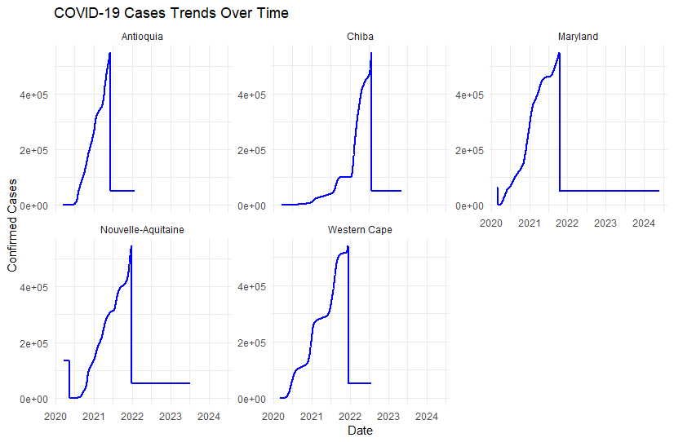
Trends Analysis for Confirmed Cases

Slide 4
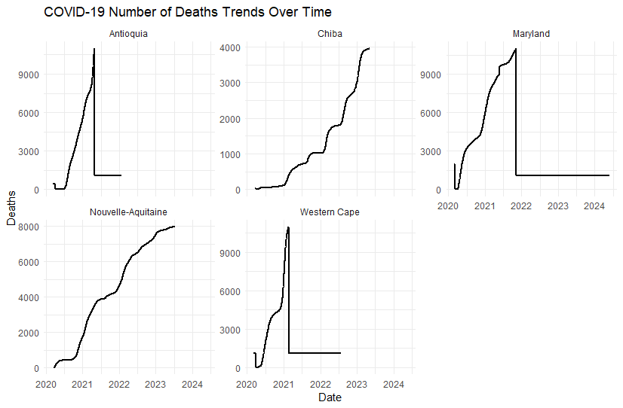
Trends Analysis for Deaths

Slide 5
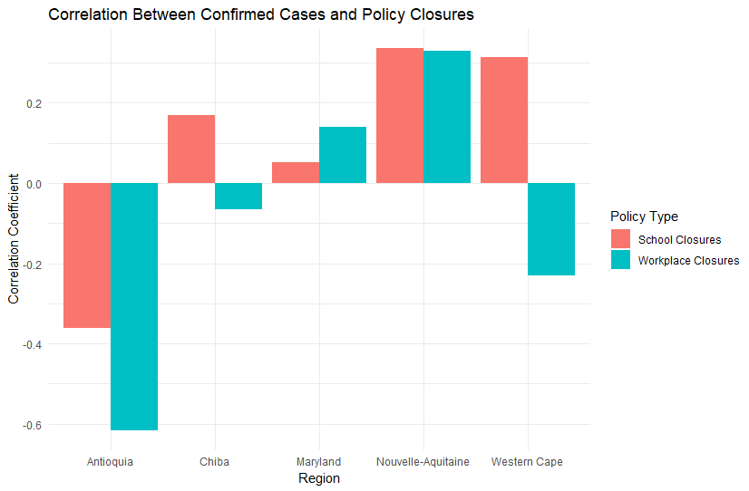
Policy Impact and Correlation Analysis

Slide 6
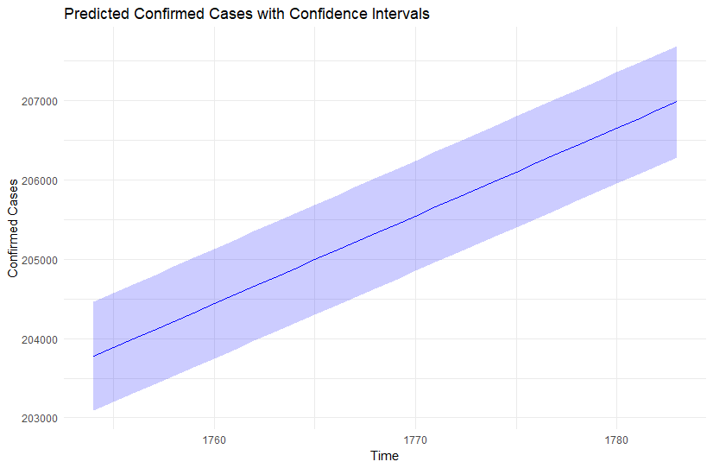
Predictive Modeling with Confidence Interval for Future Confirmed Cases

Slide 7
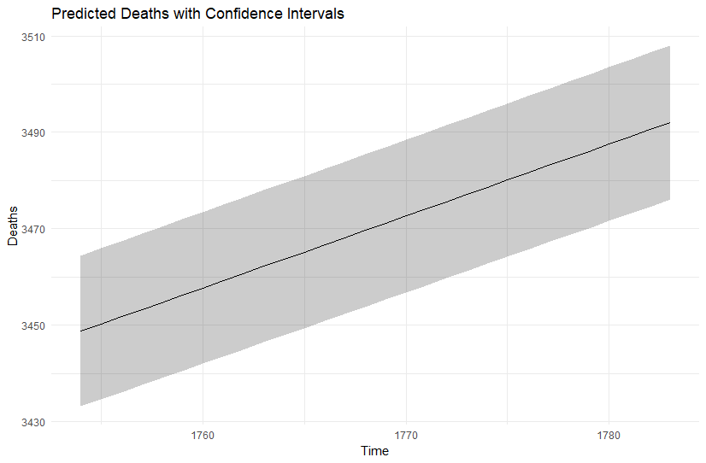
Predictive Modeling with Confidence Interval for Future Deaths

Slide 8
Conclusion
The analysis of the COVID-19 dataset highlights critical insights into the trends, impacts of interventions, and future projections for confirmed cases and deaths across various regions.
Government interventions, particularly school closures and workplace closures, were associated with slower growth in COVID-19 cases.
Predictive modeling shows promise for forecasting future cases and deaths, though uncertainty increases with longer time horizons.

